Slide 1


Amazon Deforestation Time Series Analysis
By ~ Team GeoGlobetrotters
Sanjeevani Lakade (202151139)
Om Waikar (202152344)

Slide 2
Introduction

Slide 3


Introduction and Objective
Explore Amazon deforestation dynamics using Google Earth Engine (GEE). Leveraging the Hansen Global Forest Change dataset, our objectives include loading, visualizing, and filtering data to unveil annual deforestation rates. We showcase the evolving landscape of the Amazon from 2000 to 2022 gaining valuable insights into environmental changes shaping one of the world's most critical ecosystems.

Slide 4
2. About Amazon Rainforest

Slide 5
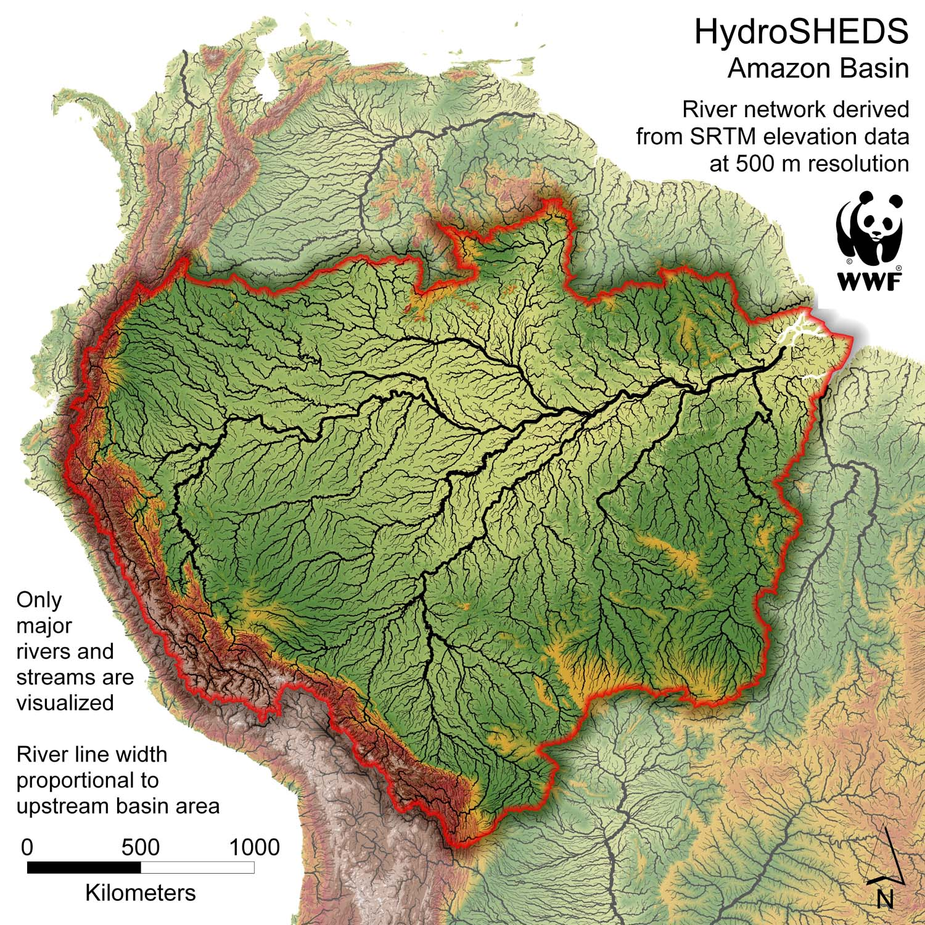
About Amazon Rainforest
Choosing the Amazon Basin as Our Study Area
Extent of the Amazon Rainforest:
The Amazon rainforest covers a substantial portion of the Amazon Basin.
Known for its unparalleled biodiversity and ecological significance.
Geographical Significance:
Majority of the Amazon rainforest is situated within the Amazon Basin.
Comprising a mosaic of ecosystems, it represents a microcosm of global biodiversity.
Quantifying the Area:
The Amazon Basin covers an extensive area of land.
Approximately 7 million square kilometers or 700 million hectares.

Slide 6
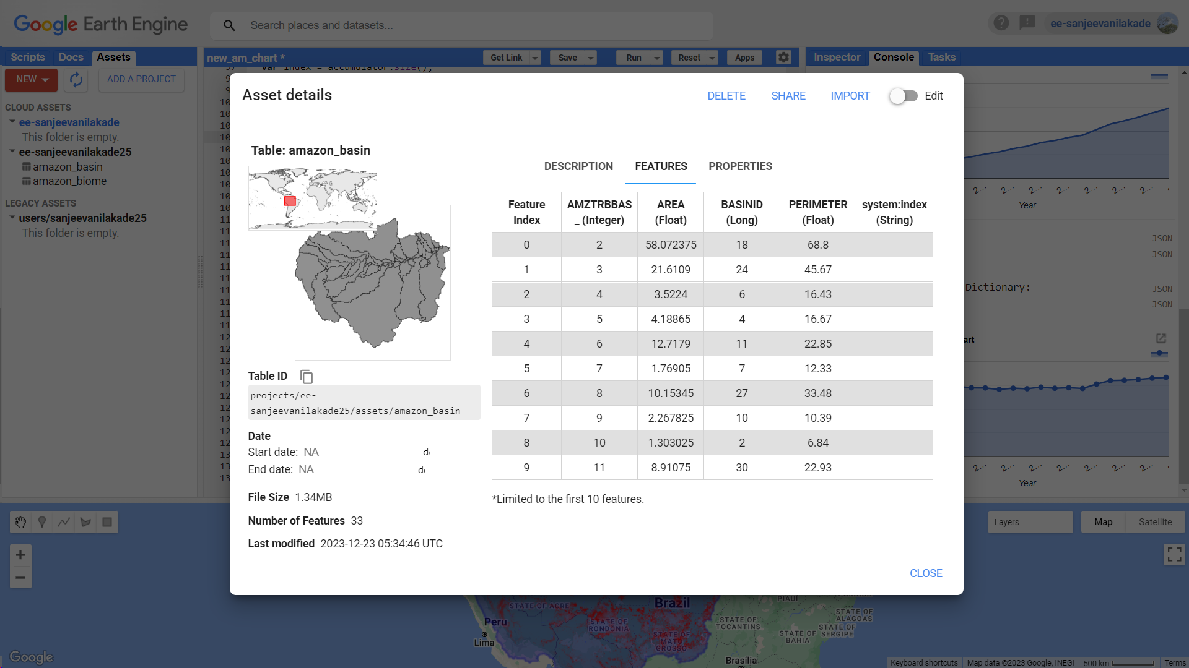
Study Area - Amazon Basin
Source:
https://daac.ornl.gov/LBA/guides/CD06_CAMREX.html
https://daac.ornl.gov/cgi-bin/dsviewer.pl?ds_id=1086

Slide 7
3. Stepwise Procedure
Project Code https://code.earthengine.google.com/349b4b05936a77786f0ebf0b5c839db5?noload=true

Slide 8
Stepwise Procedure
Step 1 : Load and Visualize Amazon Region Geometry
// Load the Amazon region geometry
var amazonRegionGeometry = ee.FeatureCollection("projects/ee-sanjeevanilakade25/assets/amazon_basin").geometry().dissolve({'maxError': 1});
print('Amazon Region Geometry:', amazonRegionGeometry);
// Add the Amazon region geometry to the map for visualization
Map.addLayer(amazonRegionGeometry, {color: 'blue' }, 'Amazon Rainforest Geometry', true, 0.5);
// Load the Hansen Global Forest Change dataset
var forestChangeImage = ee.Image("UMD/hansen/global_forest_change_2022_v1_10").select(['lossyear']).clip(amazonRegionGeometry);
print('Forest Change Image:', forestChangeImage);
// Center the map on the region of interest
Map.centerObject(amazonRegionGeometry, 4);
// Display the forest loss image on the map
Map.addLayer(forestChangeImage, {bands: ['lossyear'], palette: ['FF0000']}, 'Forest Loss');
This part loads the geometry of the Amazon Basin, specifically a shapefile stored in Earth Engine Assets. The ‘dissolve’ function is used to merge the geometries into a single polygon. The geometry is then added to the map for visualization.
This script loads and clips the Hansen Global Forest Change dataset, selects the 'lossyear' band, prints information about the image, and centers the map on the Amazon region for visualization

Slide 9
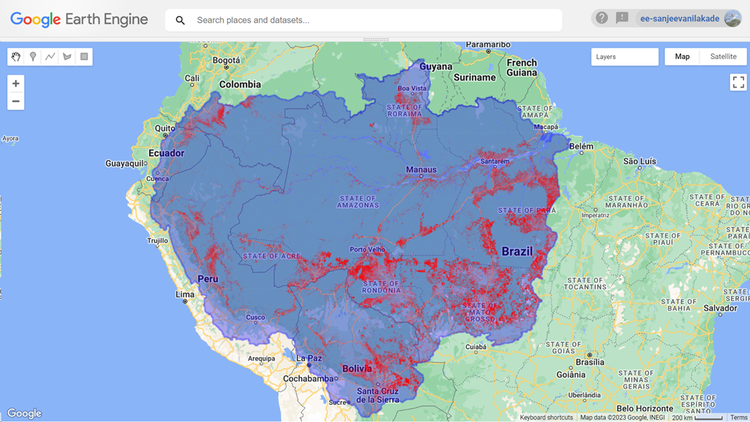
Output:

Slide 10
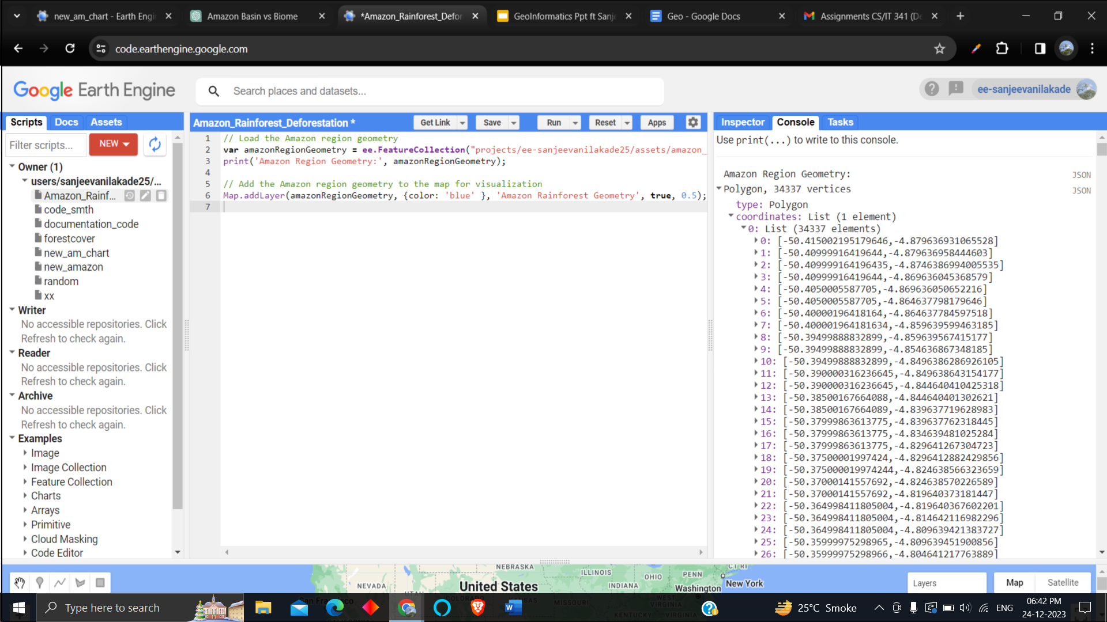
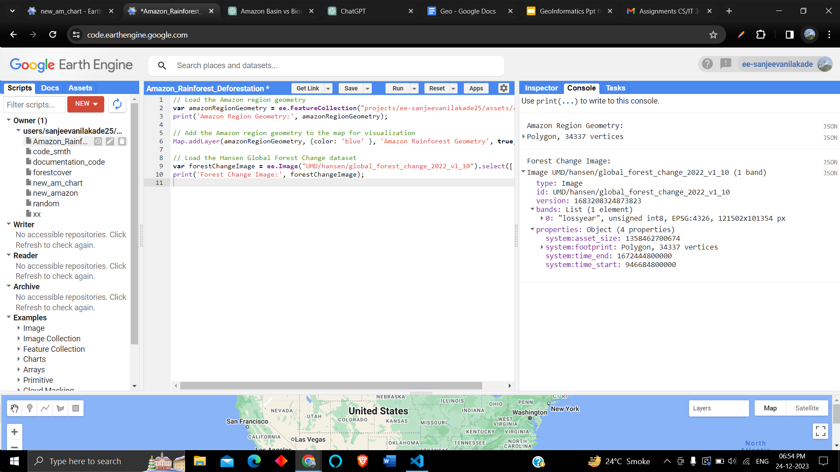
Output:

Slide 11
Stepwise Procedure
Step 2 : Map over Years and
Calculate Deforestation Area
// Define the years of interest
var yearsOfInterest = ee.List.sequence(0, 22);
// Map over the years and calculate deforestation area
var deforestationAreas = yearsOfInterest.map(function(year) {
var lossYearMask = forestChangeImage.eq(ee.Number(year)).selfMask();
var pixelAreaImage = lossYearMask.multiply(ee.Image.pixelArea());
var areaStats = pixelAreaImage.reduceRegion({
reducer: ee.Reducer.sum(),
geometry: amazonRegionGeometry,
scale: 200,
maxPixels: 1e14
});
// Convert the image value to a Number
var lossArea = ee.Number(areaStats.get('lossyear'));
// Multiply pixel area by loss area (assuming 'lossyear' represents loss area)
var deforestationArea = lossArea.multiply(0.0001);
return lossYearMask.set('area', deforestationArea)
.set('year', ee.String(ee.Number(year).add(2000).toInt()));
});
// Create an ImageCollection from the mapped result
var deforestationImageCollection = ee.ImageCollection.fromImages(deforestationAreas);
print('Deforestation Image Collection:', deforestationImageCollection);
It defines a list of years and maps over each year to calculate the deforestation area for the Amazon Basin. The detailed explanation is provided in the next comment block.
For each year, it creates a mask based on forest loss, calculates the pixel area, and aggregates the area statistics for the specified region. It then converts the result to hectares and adds metadata (year) to each image. Finally, an Image Collection is created from the mapped result.

Slide 12
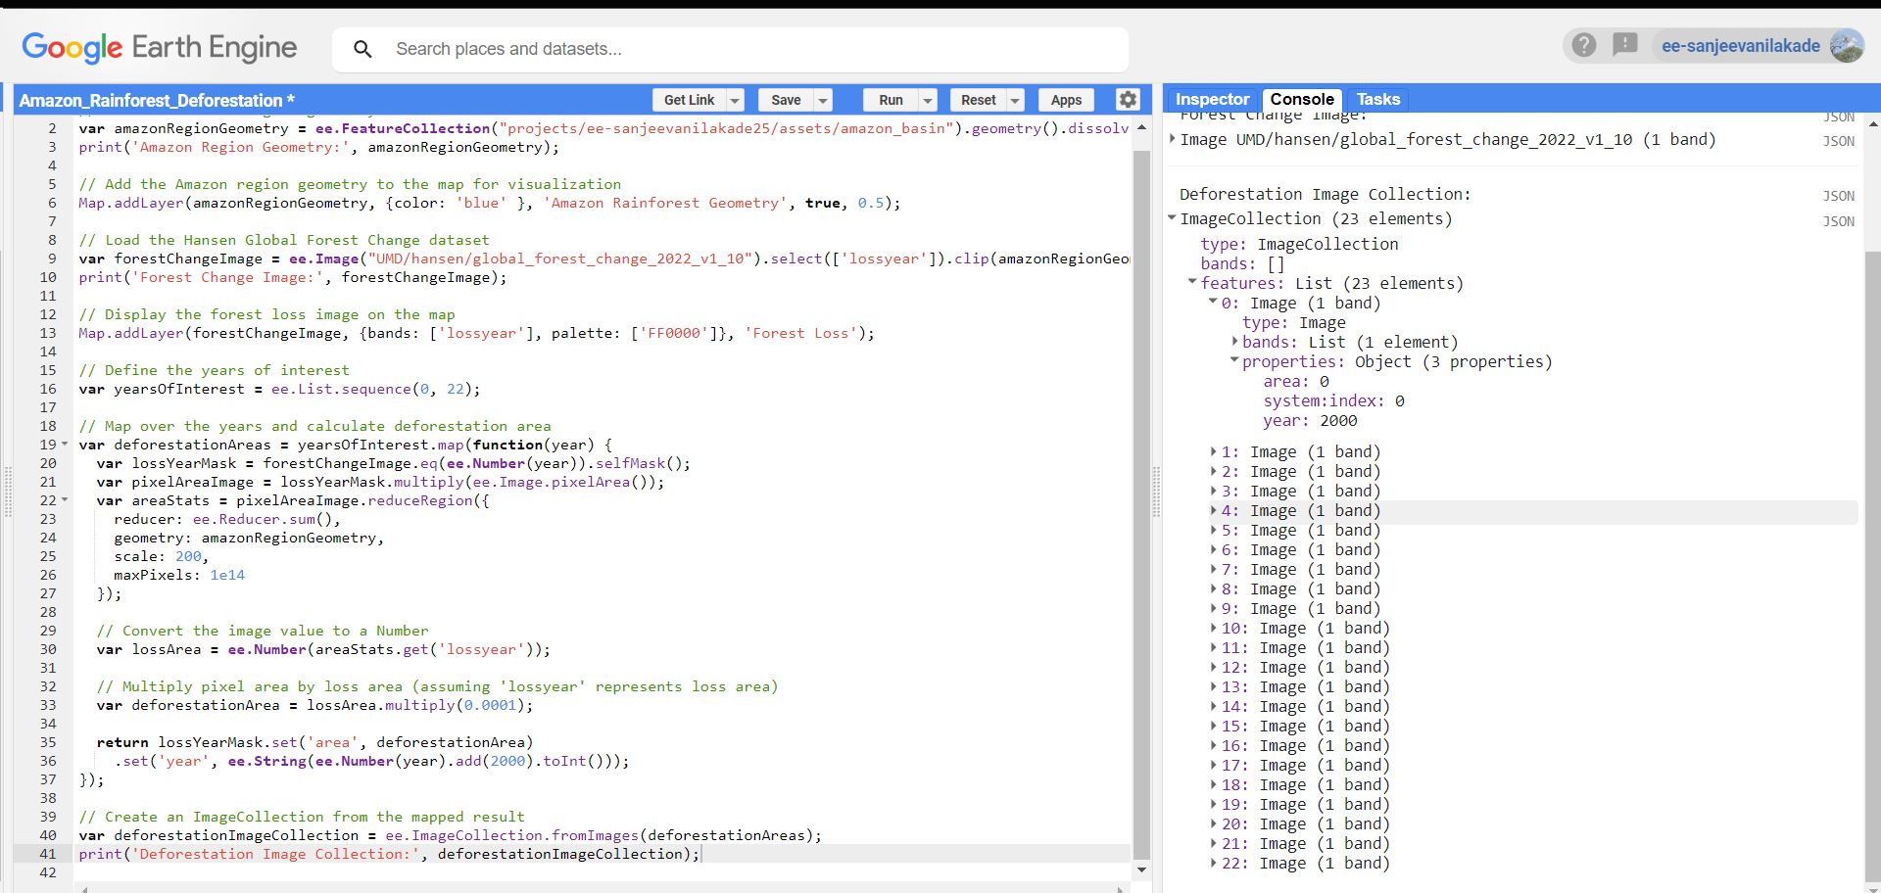
Output:

Slide 13
Stepwise Procedure
Step 3 : Aggregate Results for Charting
// Aggregate the results for charting
var yearsList = deforestationImageCollection.aggregate_array('year');
var deforestationAreasList = deforestationImageCollection.aggregate_array('area');
var deforestationData = ee.Dictionary.fromLists(yearsList, deforestationAreasList);
print('Deforestation Data:', deforestationData);
// Create an area chart for deforestation
var deforestationChart = ui.Chart.array.values({
array: deforestationData.values(),
axis: 0,
xLabels: deforestationData.keys()
}).setChartType('AreaChart').setOptions({
title: 'Deforestation Over the Years',
hAxis: {title: 'Year'},
vAxis: {title: 'Deforestation Area (in hectares)'}
});
// Print the deforestation chart
print('Deforestation Chart:', deforestationChart);
It aggregates the calculated deforestation areas and years into a dictionary for charting.
It uses the aggregated data to create an area chart for deforestation over the years.

Slide 14
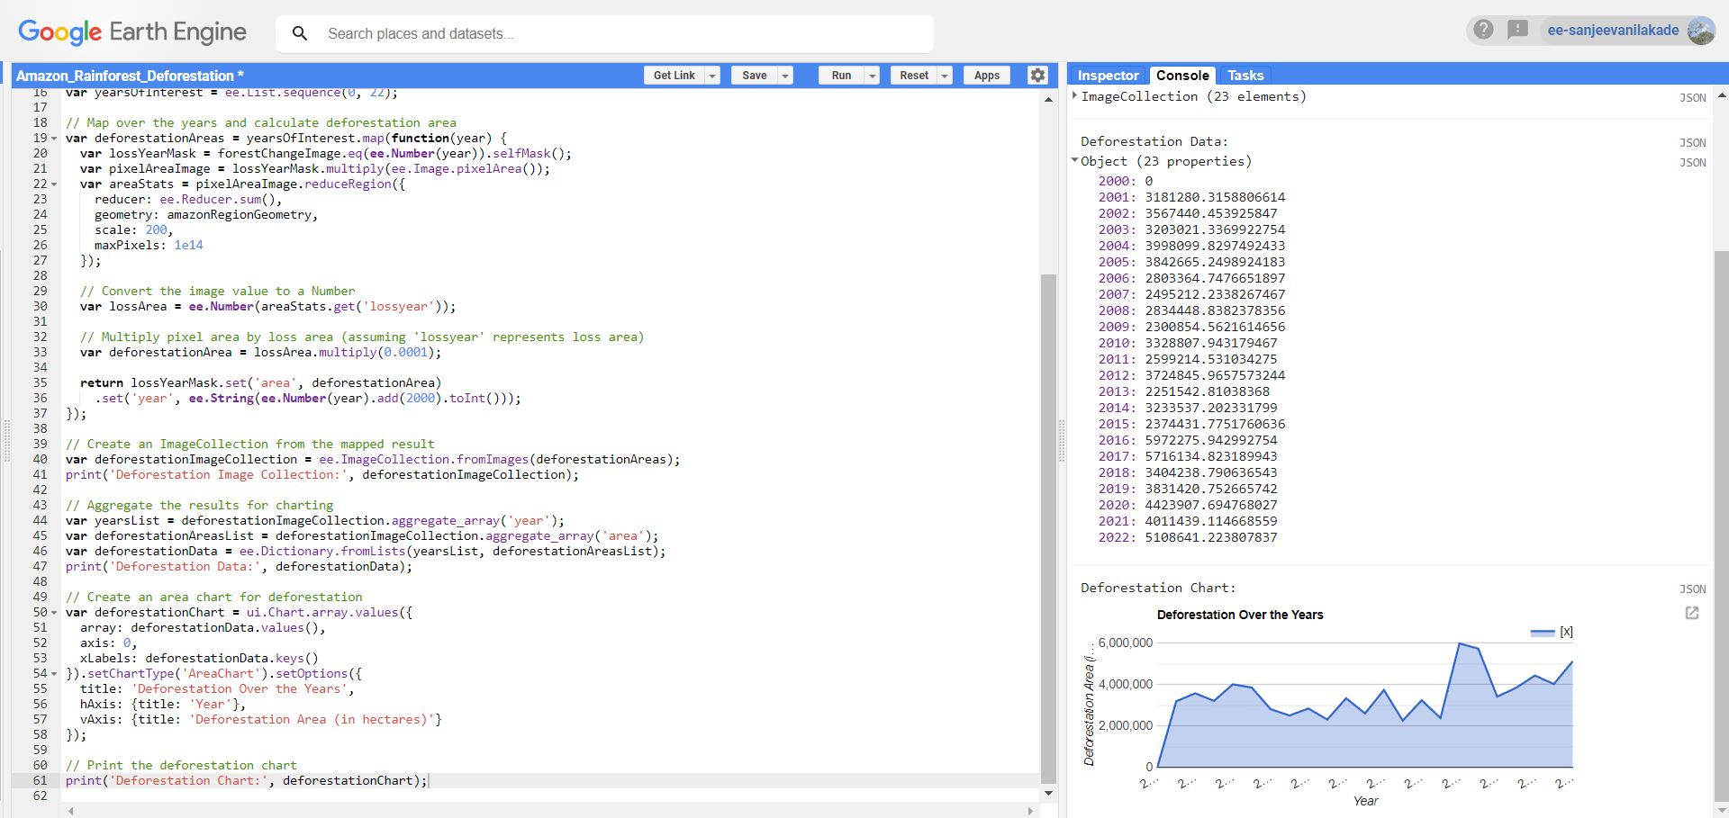
Output:

Slide 15
Stepwise Procedure
Step 4 : Calculate Cumulative Deforestation
// Function to calculate cumulative sum with modified logic
var cumulativeSum = function(element, accumulator) {
accumulator = ee.List(accumulator);
return accumulator.add(ee.Number(element).add(accumulator.get(-1)));
};
// Apply cumulative sum function to the list
var cumulativeDeforestationList = deforestationAreasList.iterate(cumulativeSum, ee.List([0]));
print('Cumulative Deforestation List:', cumulativeDeforestationList);
// Convert the cumulative list to a dictionary with years as keys
var cumulativeDeforestationDict = ee.Dictionary.fromLists(yearsList, ee.List(cumulativeDeforestationList).slice(1));
print('Cumulative Deforestation Dictionary:', cumulativeDeforestationDict);
// Create an area chart for cumulative deforestation
var cumulativeDeforestationChart = ui.Chart.array.values({
array: cumulativeDeforestationDict.values(),
axis: 0,
xLabels: cumulativeDeforestationDict.keys()
}).setChartType('AreaChart').setOptions({
title: 'Cumulative Deforestation Over the Years',
hAxis: {title: 'Year'},
vAxis: {title: 'Cumulative Deforestation Area (in hectares)'}
});
// Print the cumulative deforestation chart
print('Cumulative Deforestation Chart:', cumulativeDeforestationChart);
It defines a function to calculate the cumulative sum and applies it to the list of deforestation areas, resulting in a cumulative deforestation list.
It converts the cumulative list to a dictionary and creates an area chart for cumulative deforestation over the years.

Slide 16
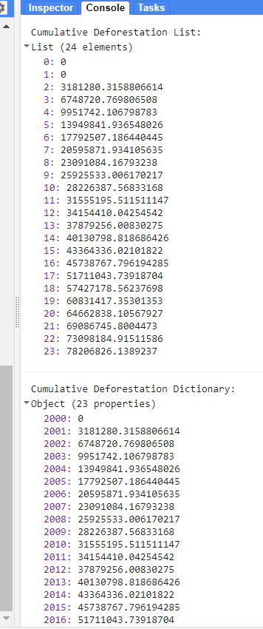
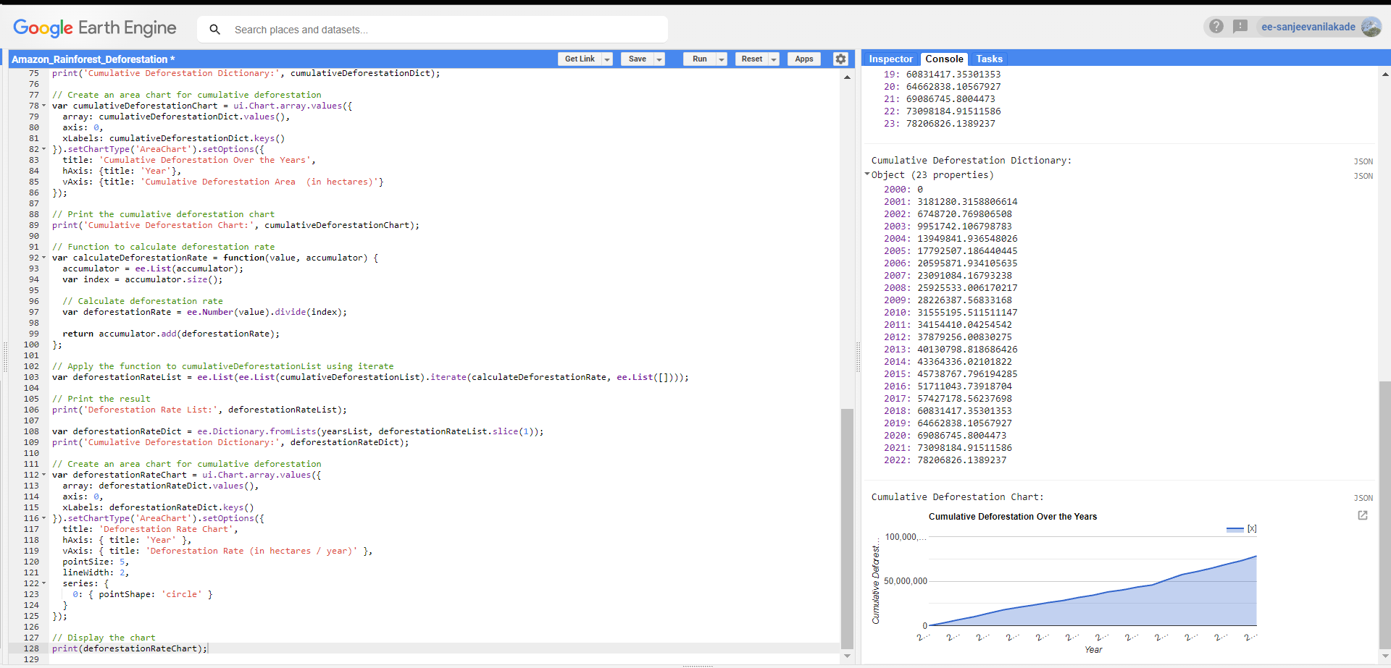
Output:

Slide 17
Stepwise Procedure
Step 5 : Calculate Deforestation Rate
// Function to calculate deforestation rate
var calculateDeforestationRate = function(value, accumulator) {
accumulator = ee.List(accumulator);
var index = accumulator.size();
// Calculate deforestation rate
var deforestationRate = ee.Number(value).divide(index);
return accumulator.add(deforestationRate);
};
// Apply the function to cumulativeDeforestationList using iterate
var deforestationRateList = ee.List(ee.List(cumulativeDeforestationList).iterate(calculateDeforestationRate, ee.List([])));
// Print the result
print('Deforestation Rate List:', deforestationRateList);
var deforestationRateDict = ee.Dictionary.fromLists(yearsList, deforestationRateList.slice(1));
print('Cumulative Deforestation Dictionary:', deforestationRateDict);
// Create an area chart for cumulative deforestation
var deforestationRateChart = ui.Chart.array.values({
array: deforestationRateDict.values(),
axis: 0,
xLabels: deforestationRateDict.keys()
}).setChartType('AreaChart').setOptions({
title: 'Deforestation Rate Chart',
hAxis: { title: 'Year' },
vAxis: { title: 'Deforestation Rate (in hectares / year)' },
pointSize: 5,
lineWidth: 2,
series: {
0: { pointShape: 'circle' }
}
});
// Display the chart
print(deforestationRateChart);
It defines a function to calculate the deforestation rate and applies it to the cumulative deforestation list, resulting in a list of deforestation rates.
It converts the deforestation rate list to a dictionary and creates an area chart for the deforestation rate over the years with additional styling options like point size and line width.

Slide 18
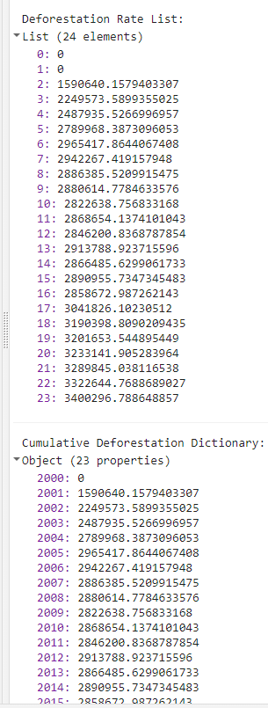
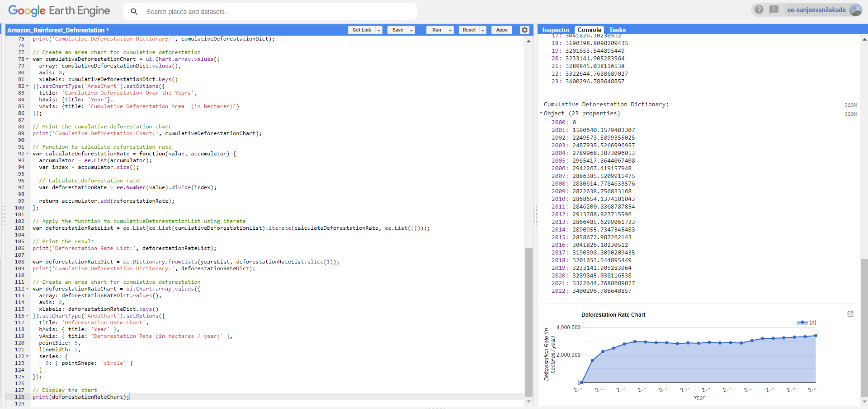
Output:

Slide 19
4. Amazon Deforestation
Time Series Analysis

Slide 20
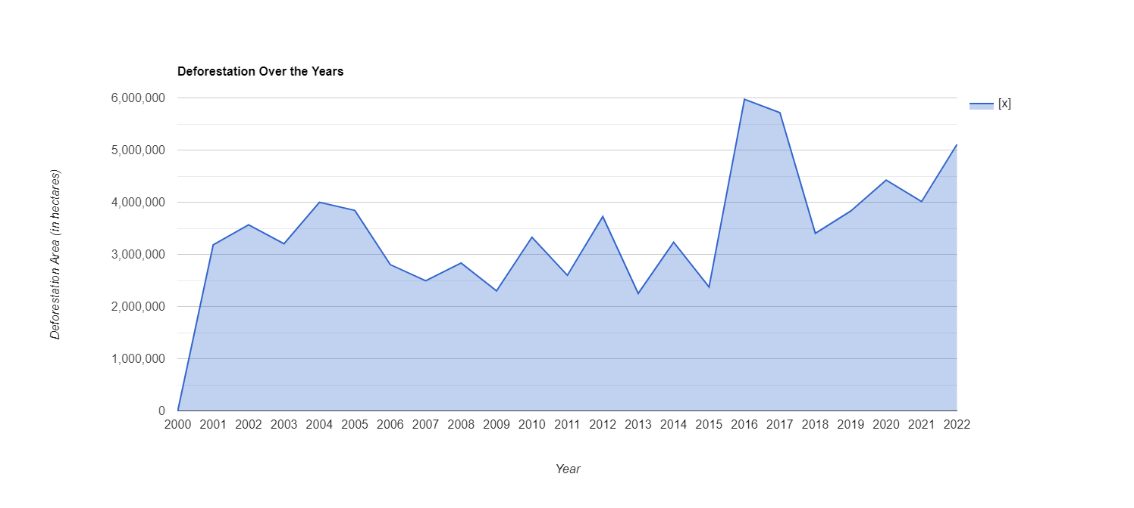
Deforestation Over the Years
Yearly deforestation varied from 2,000,000 to 3,500,000 hectares, sharply escalating to 6,000,000 hectares in 2016-2017. Subsequently, it stabilized around 400,000 hectares, spiking to 500,000 hectares in 2022.

Slide 21
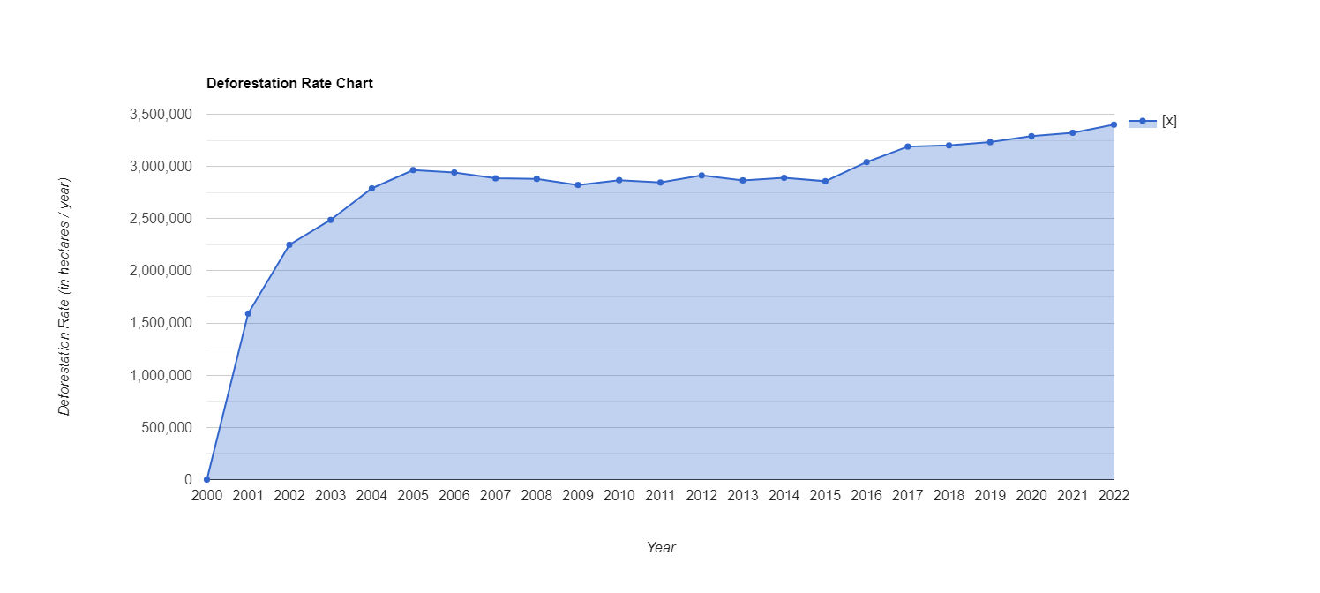
Deforestation Rate Chart
Deforestation rates doubled from 1,500,000 to 3,000,000 hectares/year during 2001-2002, remained constant at 3,000,000 hectares/year from 2002-2016, signifying stability. However, a linear increase began in 2016, reaching approximately 350,000 hectares/year by 2022, indicating a renewed upward trend.

Slide 22
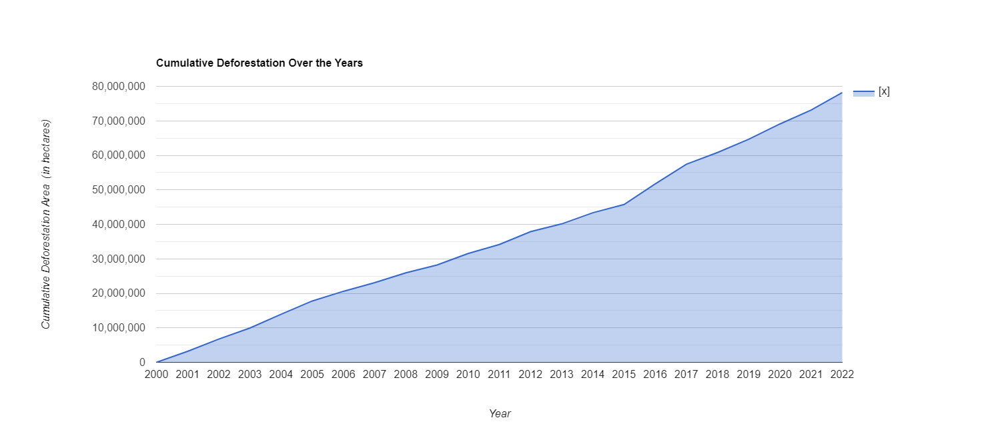
Cumulative Deforestation Chart
In the first decade (2000-2010), cumulative deforestation amounted to approximately 30,000,000 hectares. The second decade (2010-2022) witnessed a stark increase, surging from 30,000,000 to 80,000,000 hectares.

Slide 23
New ideas to extend the work
Early Warning System:
Develop ML models for deforestation prediction.
Enable proactive conservation planning.
Interactive Visualization:
Real-time updates and educational resources.
Increase public awareness and support for sustainability.
Carbon Emission Mitigation:
Estimate emissions from deforestation.
Explore offset projects via reforestation.
Land Cover Classification:
Analyze various land cover changes for a holistic view.
Community Engagement:
Integrate socio-economic data.
Collaborate on sustainable practices and policies.

Slide 24
THANK YOU !

